Slide 1
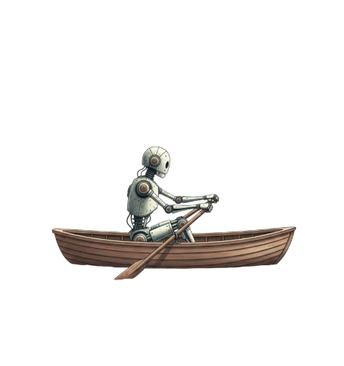
Are We Bold Enough?
Leading with AI through the age of acceleration
Nadia Ellis - AI Strategy, Solutions, Capability
Notes:
the only thing that has worse approval ratings than Donald Trump in the US right now is AI

Slide 2
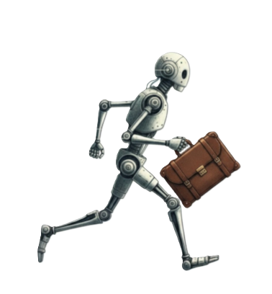

Effort & Time ≠ Value.
Notes:
Identity wrapped up in work
Decades of effort and commitment reduced to the click of a button.
Add to that the pace of AI change

Slide 3
Our thinking is linear.
AI progress is exponential.
10-100× smarter & faster.
Notes:
Most business planning assumes we can see the next few steps clearly enough to plan around them. AI is not moving like that.
AI is developing on an exponential growth curve, becoming 10x to 100x smarter and faster every year, a pace that is difficult for humans, who think in linear paths, to comprehend.
The pace is why leaders can feel behind even when they are paying attention.
This discomfort is the norm in an age of acceleration. Now not everyone has direct experience of this. Alternate reality.

Slide 4
Measuring AI velocity
> 500% capability leap in just 12 months
> 3-hour tasks executed at ~80% accuracy
> And it does it radically faster and cheaper
Notes:
Coding Agents are a great example of AI velocity.
They’ve measured AI capability across a series of tech tasks.

Slide 5
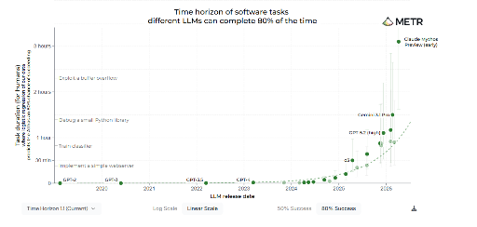
Notes:
Look at the curve over the last 12 months.
And the latest model – mythos - has turned the curve into more of a wall.
This is not a measure of all jobs. But is is a clear undeniable signal.
AI will impact every sector and every knowledge job. It is undeniable.
And it is happening at lightspeed.

Slide 6
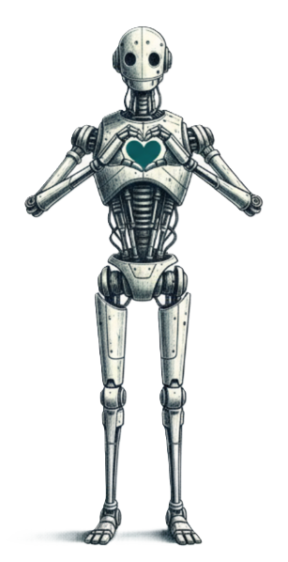
Waiting for certainty is not a strategy.
How will you lead?
Notes:
The organisations that move well now will build confidence, capability, and judgement while others are still tr.ying to decide where AI should be coded in the budget. Disconnected from your first hand experience.

Slide 7
Most people…
The reality… AI is already
FREE TOOLS
SIMPLE PROMPTS
.
COPY & PASTE
Connected to business
Has permission to act Using tools
SMART GOOGLE
SAME PROMPT… EVERY TIME.
TO GET THINGS DONE.
Notes:
Most people try AI, get mediocre results, and conclude it is overhyped.
There are other businesses out there just like yours… using AI right now.

Slide 8
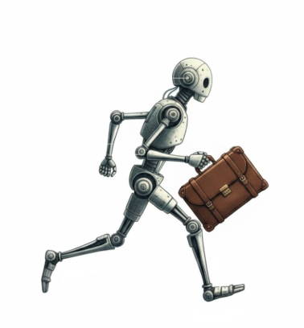

AI isn’t over-hyped.
It is under hyped.

Slide 9

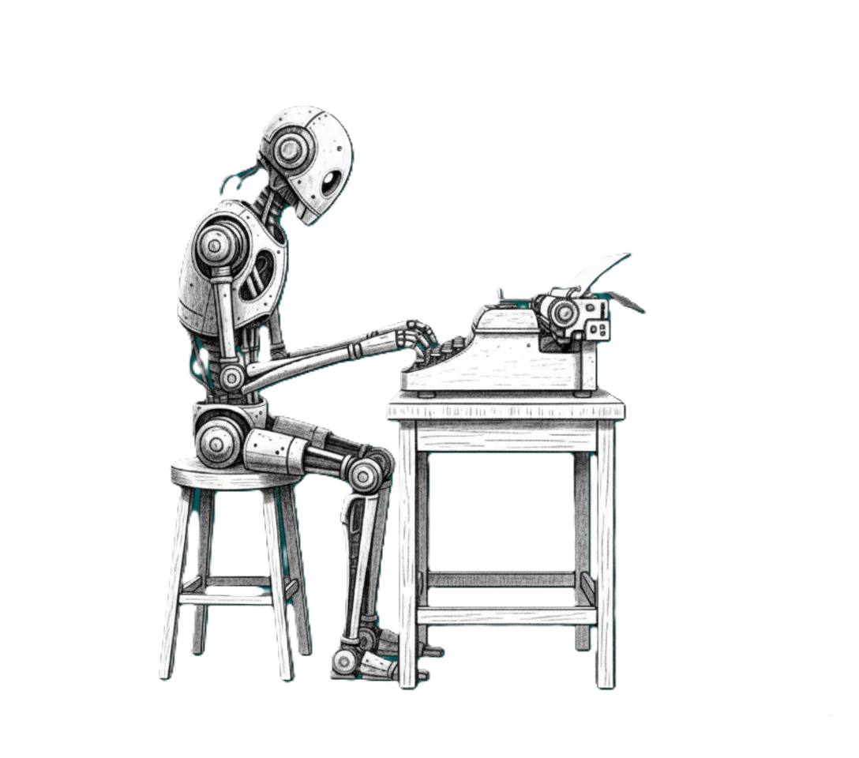
From prompting to delegating
AGENTIC AI
You set the goal. AI does the work.
AI AUTOMATION
A workflow starts. AI completes the steps.
CHAT
You ask. AI answers.
Notes:
Reactive. Waits for the prompt.
One question, one answer, one session. Then it forgets you.
Wakes up on its own. Follows the playbook you gave it
Predictable steps, predictable outcomes.
A digital teammate with tools, memory, and a mandate.
You hand it the goal. It figures out the how, and tells you when it's done.
What is the key to unlocking value across all of these types?

Slide 10

Treat AI Like a Digital Team Mate
Onboarding
Values, customers, market, team,
Tech stack.
Job Description
Responsibilities, Expertise,
KPIs
Task Briefs
The task at hand, with enough detail for the stakes
Feedback
What worked. What didn’t.
Timely. Clear. Regular
Examples
What does “good’ look like. Clear Expectations
"You wouldn't send someone to organise a 100-person event with the same brief as a coffee run."
Notes:
Most people expect AI to be some kind of oracle. They give it something generic and get a generic answer. When we talk to humans, we rely on shared assumptions. If I say, "Go to the store and pick up some milk," a person knows the hidden steps: go to the store, pick up the milk, pay for it, bring it home, put it in the fridge. AI does not share all of that context unless we make the outcome clear.
So treat it like a teammate.

Slide 11
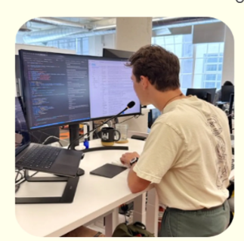
Stop typing
Just talk
Notes:
In the future we’ll wispr to our Ais rather than typing. We type 60 words per minute. We can talk 90-120
This changes the way we interact with A. So you can brief it like you would an employee or consultant in a few minutes

Slide 12


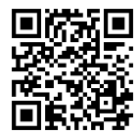

The 10 minute brief🎙️
Notes:
When you’re chatting with AI this is a great framework. That will 10x your results. Yarn with it.
What is the context
Give AI the full picture. Who you are, what the problem is, who this is for. In this example IAI implementation proposal to our management team. Company. Operations. Strategy. Risks.
Expertise.
Act as the kind of consultant a good CEO would bring in before a serious management-team decision. Favourite thought leaders? Drop them in.
Brene Brown, Simon Sinek. Whatever the task requires from you. Task;
Be specific. Stress-test this AI implementation proposal before I take it to the management team. Help me poke holes in this from the perspective of Operations, Marketing, Finance Questions.
Ask me 3-5 clarifying questions, one at a time. So you have all the necessary info. If you don’t give AI the opportunity to ask questions then it will generalize, or guess. That is dangerous.

Slide 13
Chatting? Use YETI
Yarn
Expertise
Task
Interview
Give AI the full picture. Who you are, what the problem is, who this is for.
Describe the expertise this task needs. Layer the skills. Give them a Role
What is the goal. Be specific about format, quality bar, and what "done" looks like.
Hand over control. "Ask me up to three questions, one at a time, to get the context you need."
like briefing a consultant or colleague. Use it for thought partnership. Use it anytime you need AI to think with you.
Notes:
Didn’t remember all that? Here’s the slide for you to refer back later. Honestly this is the easiest thing to do straight away and get immediate 10x improvement from your AI.
But Chat based AI isn’t where the real ROI happens. Real changes come from the next two types. First we’re going to talk about AI Automation.

Slide 14


Automation:
Meeting Cycles
The current operating reality
Meeting follow-up
should not eat the afternoon
TRANSCRIPT & GENERIC NOTES
PREVIOUS ACTIONS
.
TYPICAL FOLLOW-UP LOAD
2-3h
EMAIL UPDATES
PROJECT NOTE
to turn one meeting into useful next steps
BOARD PACK
Notes:
Opportunites for AI automation are literally endless. But today I’m going to demo one that is pretty common across the board. MEETINGS.
Messy inputs, messy outputs, repetitive drain. Who said what, who’s action was it, did they do it… Now last year… this type of process wasn’t that easy to automate. But now it was literally easier to build an automation that in was to create a slide deck describing the process.

Slide 15
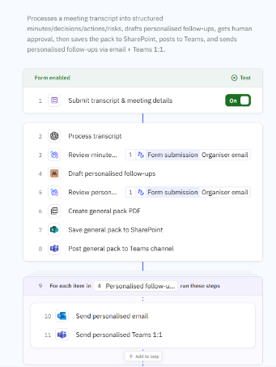
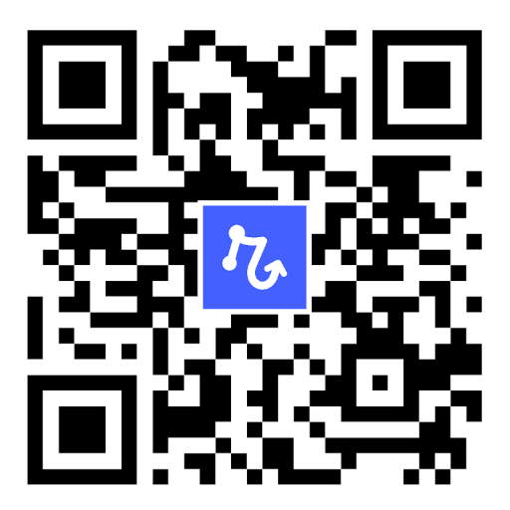
No Code.
STEP 1
Human submits the transcript
That’s the only input required from the team.
Notes:
This pre & post meeting ai automation was all build in natural language. I gave Relay.app the steps, it built the workflow. If you want to check out Relay that QR code will get you some bonus AI credits for a full year. So the meeting ends and the Admin uploads the transcript and their notes. That kicks off the workflow.

Slide 16
STEPS 2–8
AI drafts, humans approve
AI writes the minute, follow-ups and board pack. Two human checkpoints before anything leaves the building.
Notes:
Next the AI process the transcript following your specific instructions around what is important and how you like things. No more dealing with Teams generic notes complete with spelling mistakes.
Human checks and approves.
Next AI drafts personalised follow ups for each departments. So the most relevant content to them is easy to find.
Human checks that too.
AI then creates a general pack. Saves it to Sharepoint and posts to your teams channel.

Slide 17
STEPS 9–11
Personalised delivery loop
For every attendee, a tailored follow-up lands in the right channel — email and Teams 1:1.
Notes:
Then each attendee is sent a personalised email and teams message with their personalised notes.

Slide 18
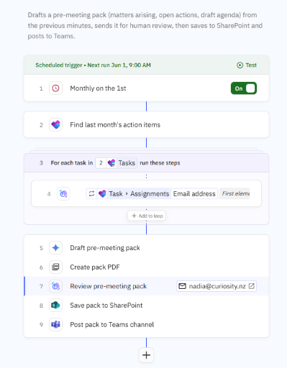
STEPS 1–4
Monthly trigger pulls last month's actions
First of the month, the workflow finds open items from Planner and emails each owner asking for a status update.
Notes:
This works at the other end too. Here is another Ai automation.
This time the AI wakes up on the 1st of the month and sends a reminder to the admin.
It then pulls all the project admin items for Microsoft Planner.

Slide 19
STEPS 5–7
AI drafts the pack, human reviews
Matters arising, open actions, and a draft agenda stitched together, then sent for human approval before publishing.
Notes:
Netxt it emails each person with a form asking them for a status update on their assigned tasks. It will gently nudge them until it is done and return that info to the admin.

Slide 20
STEPS 8–9
Save, then publish to the team
Approved pack lands in SharePoint and posts to the Teams channel — ready for the monthly review.
Notes:
Lastly it uses that information, along with the previous minutes and notes to draft a pre-meeting pack
Creates a PDF
Human reviews
Pack is saved to Sharepoint and posted to Teams.
This is a serious time saver. But this is still AI following a pretty strict set of instructions. What about Agentic Ai.

Slide 21



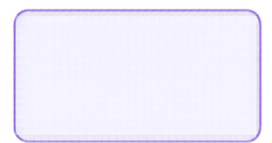







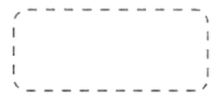



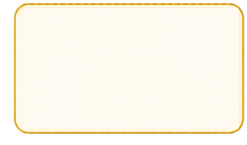

Agentic. AI that takes ACTION
Goal / Task
1. REVIEW
next step
Context, previous results
2. THINK
DONE Final Response
get results
Repeat until task complete
Reason and plan.
task complete
3. ACT
Tools,
run commands
decide
action
Notes:
Very briefly a reminder of how Agentic AI works.
You give it a goal.
The AI reviews the information it has.
Plans how to achieve the goal
Acts using tools, commands and permissions.
Reviews the work and will continue to loop until it has decided the goal is complete. Now again. This tech is widely available to all of us and you don’t need to be technical. Show I’m going to show you how this looks in Claude CoWork because they are the current leader for knowledge work. But Variations also exist in M365, Google Workspace and ChatGPTs Codex.

Slide 22
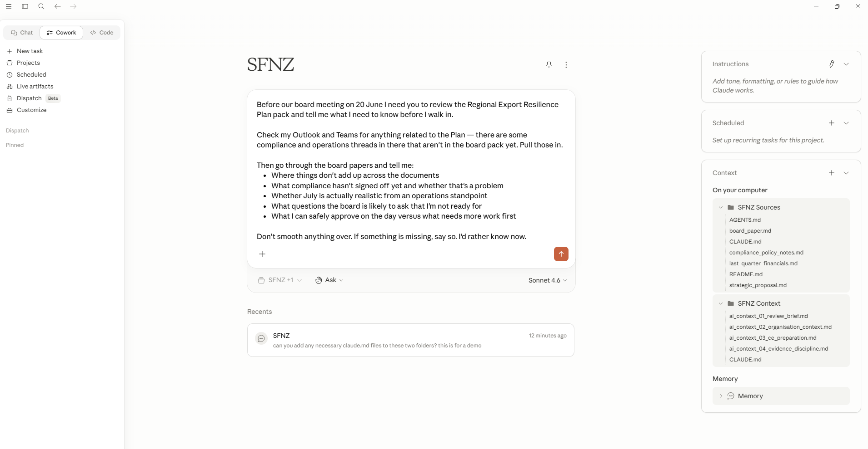
1 · THE GOAL
Brief me before the board meeting
Notes:
Scenario is being briefed before the board meeting on Regional Plan.
You give claude access to real folders that live locally on your computer.
Sources on the particular areas – Board reports.
Second Folder with all the company context – Onboarding piece.

Slide 23
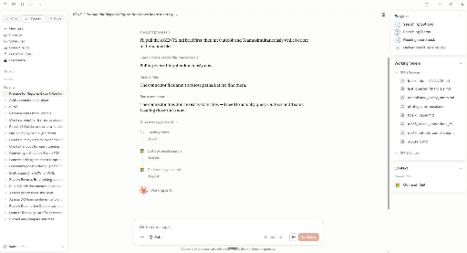
2 · IT WORKS
It makes a plan, then works with your files, and tools until complete.
Notes:
Claude then makes a plan.
Reviews the documents in the folder you’ve provided it.
And here is the cool bit… because you’ve connected it to Microsoft 365 it can also search your teams chat and inbox for relevant information.

Slide 24
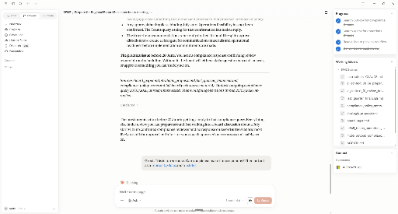
3 · REFINEMENT Responds to feedback.
Notes:
Once it has worked across all of that information, it outputs the result.
Human then provides feedback – tighten it up, output a branded word doc and slide deck on the plan.

Slide 25
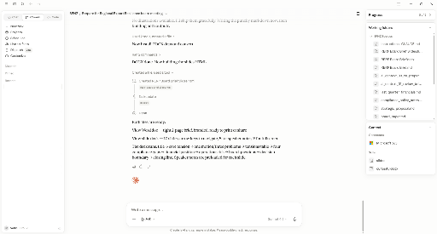
4 · GENERATION
Uses skills to output brand artefacts
Notes:
Claude then uses skills – which is a standard operating procedure for a specific task to create those branded documents.
Skills are the way you start embedding your secret sauce into AI to be easily called on at any time.

Slide 26
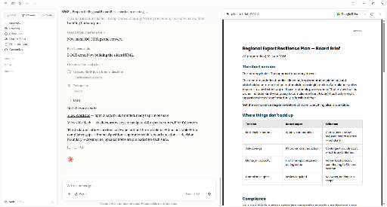
5 · THE DOC
Board-ready brief
Notes:
Claude then generates a perfectly branded word document.

Slide 27
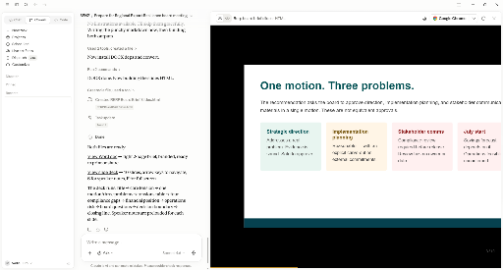
6 · THE DECK
The Slide Deck
Notes:
And slide Deck.

Slide 28
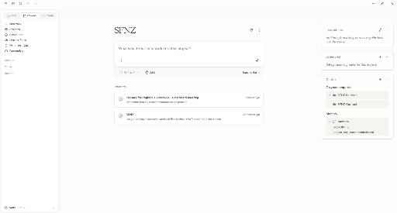
7 · THE PROJECT
Project and Memory built over time
Notes:
You can then say – remember that I agreed with the proposal. And the next time you head into the project. AI already knows what is important.

Slide 29
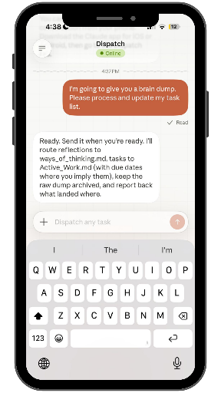
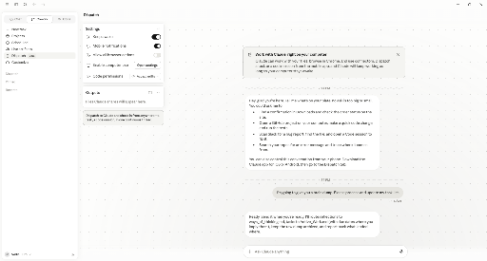
9 · DISPATCH
Talk to your agent on mobile. Claude keeps working on your desktop.
Notes:
Even more impressive. You can call on your agent from your mobile as long as your computer is awake.
Brain Dump.
None of this requires coding or technical know how.
It is a sign of what is coming next.

Slide 30


Do more with less.
humans
> Reporting
> Marketing Campaigns
> Project Management
> Leadership Briefs
AI agents
AI can follow almost any
pattern or template?
Notes:
The future of AI. Our future. Is Agents.
Each of us will have a digital team to do more with less.
The opportunities are vast.
If it follows a template or a pattern then it is an AI Opportunity.

Slide 31
So why most organisations stall?

Slide 32
Tool.
Training.
Policy.
Notes:
Most orgs start here.
Buy a tool. Run training. Write a policy.
But it is symptomatic of companies who are reaching for the solution before they have looked at the work properly.

Slide 33
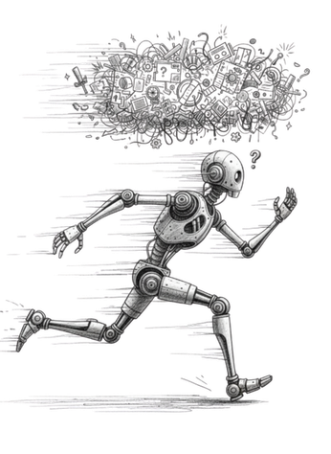
If you point AI at chaos....
you get faster chaos

Slide 34
First.
Understand
The Work.
Notes:
Which tools are people using?
Which accounts are they using?
What data is going in?
Who reviews the output?
Where does information live undocumented in heads.?
When I work with companies many solutions aren’t AI. They are process and system solutions. Mapping the work before adding technology ensures you’re solving the right problems.
Second reason companies stall.

Slide 35
90% People
10% Tech
Notes:
This cannot be delegated to IT.
IT has a serious role, especially for security and systems.
This is complex change as we’ve known it in the past.
But the pace is dizzying.
AI adoption demands leadership, vision, trust, systems thinking, and accountability.

Slide 36
“Oh boy…an 8 hour
productivity gain”
Notes:
Because let’s face it.

Slide 37
Anyone can use AI to save money & time.
The innovators will free their people
to reimagine
how works get done.

Slide 38
What is your vision?
Notes:
What is your vision?
What is the incentive for your people at all levels of the organisation?
What is the expectation following AI taking 10% of their work?
Is it a 4 day work week.
Is it survival.
Is it moving you towards your purpose.

Slide 39
Stop dabbling. Start leading.
Top down. Bottom up. Everyone Rows.
Notes:
Make it safe
Show and tell, always.

Slide 40
Find your fizzers
Pay for a subscription.
Start small, move fast.

Slide 41

Ngā Mihi
Q&A
Nadia Ellis
Joe Sutheran
www.curiosity.nz
www.linkedin.com/in/nadia-ellis/
www.growthmediumai.com
www.linkedin.com/in/nadia-ellis/

